Slide 1

GOSIM
Conference
Unleash The Potential of Every Mobile Device Through Open Mobile Hub
Preston Lau plau@futurewei.com

Slide 2


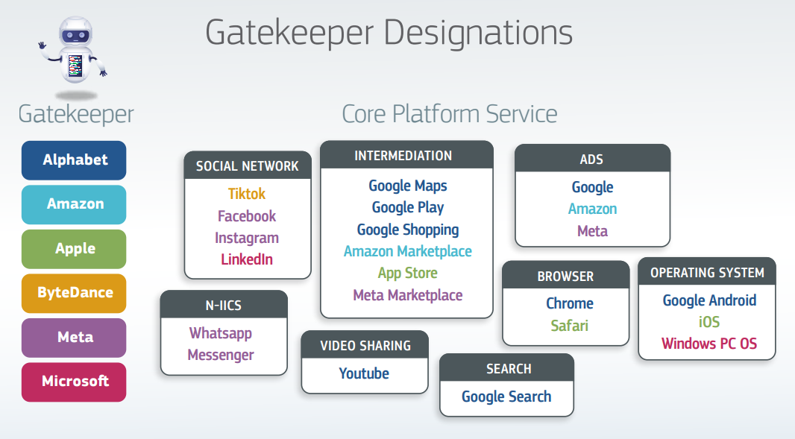
A vision for an open mobile ecosystem Offering more choices to the consumers
Source : https://www.ntia.gov/report/2023/competition-mobile-app-ecosystem
Source: https://ec.europa.eu/commission/presscorner/detail/en/ip_23_4328

Slide 3
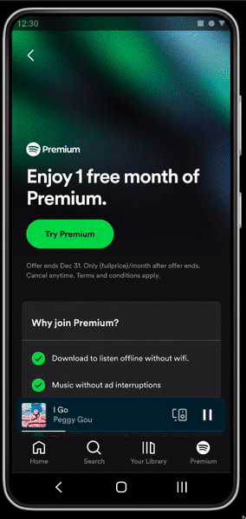
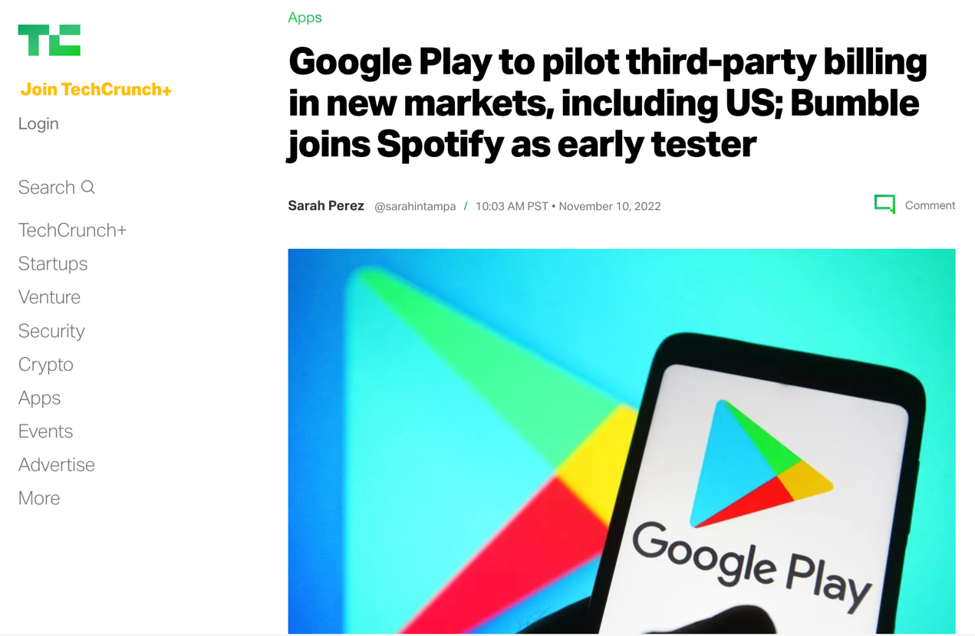
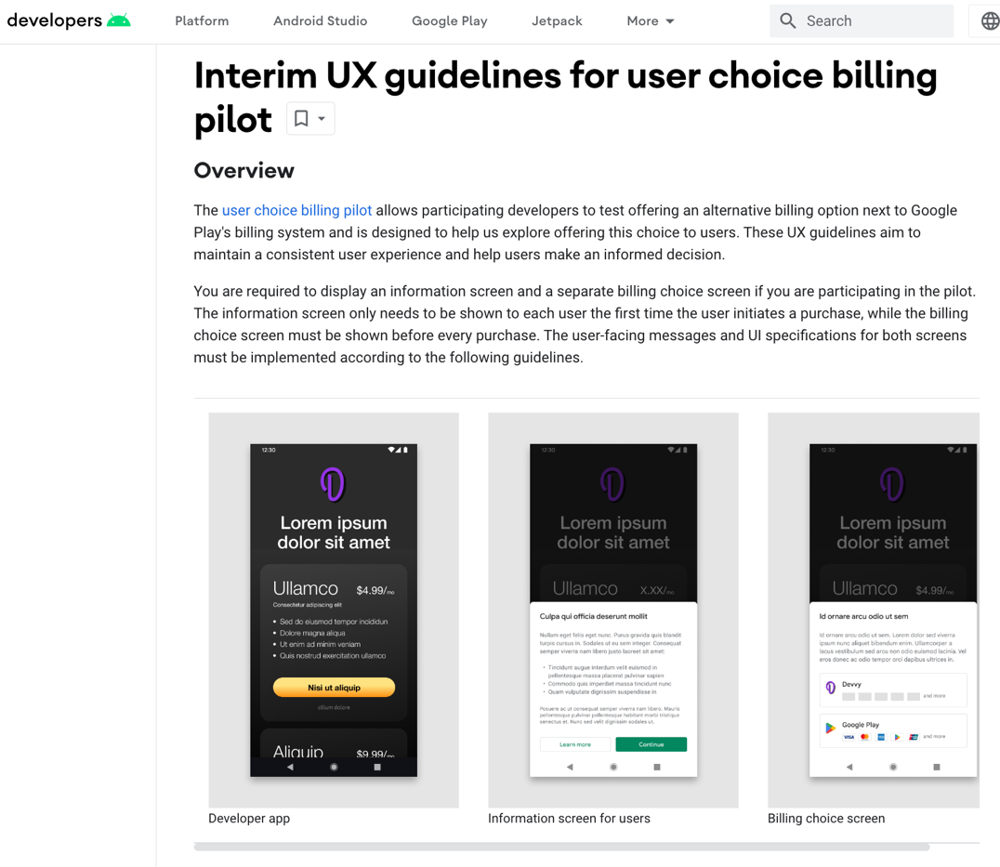
Google Updates to Android and Google Play in India
OEMs can license individual Google apps for preload
Indian users can choose their default search engine
Updating the Android compatibility to build non-compatible or forked variants
User choice billing to choose an alternative billing system
Changes to the Android installation flow and auto-updating capability for sideloaded apps and app stores.
Source : https://blog.google/intl/en-in/updates-to-android-and-google-play-in-india/

Slide 4
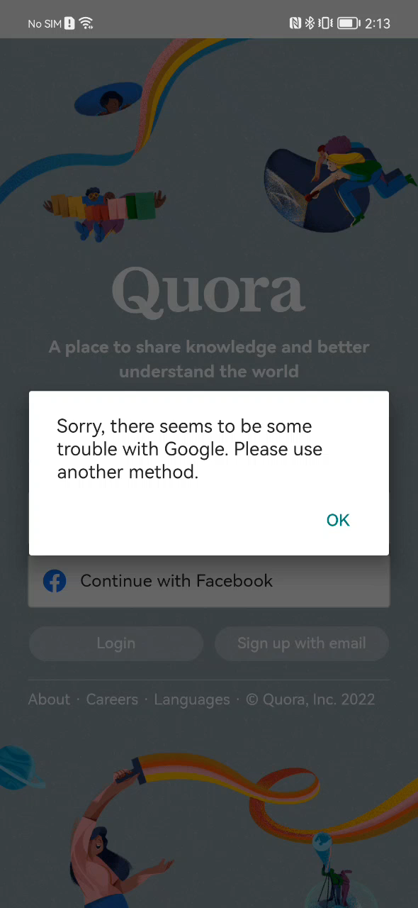
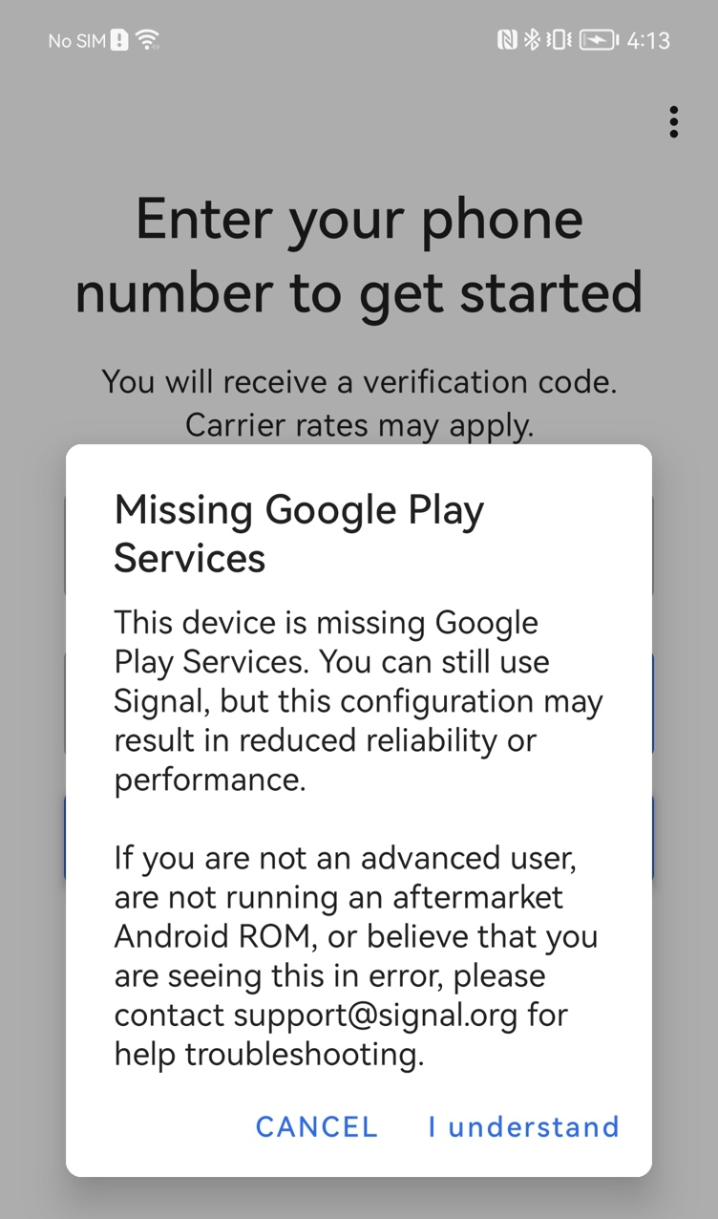
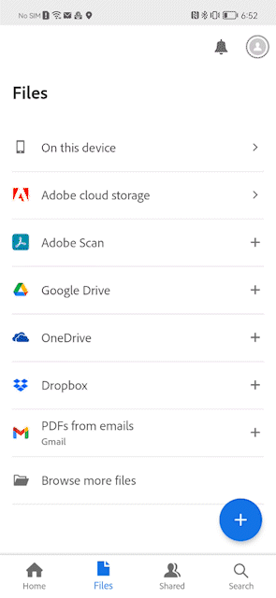
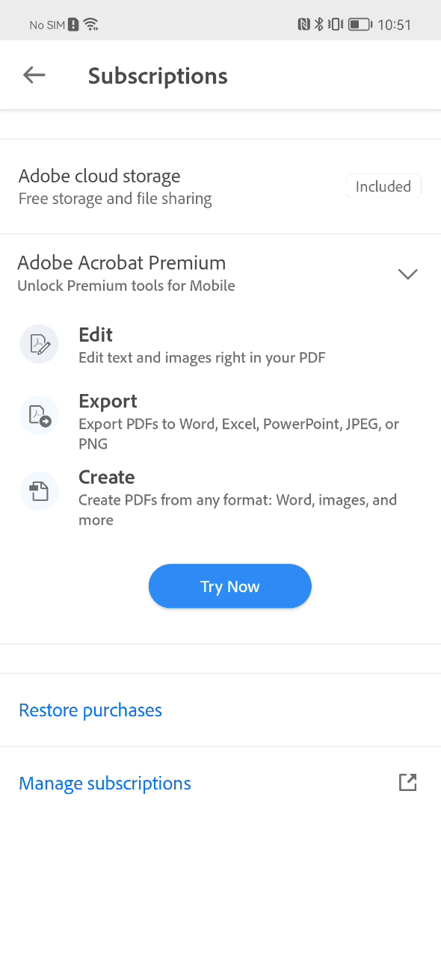
Apps Developers Challenges to Deliver Consistent User Experience
Google Login Authentication
Missing GMS Play Services
Google Drive Access
Google IAP

Slide 5
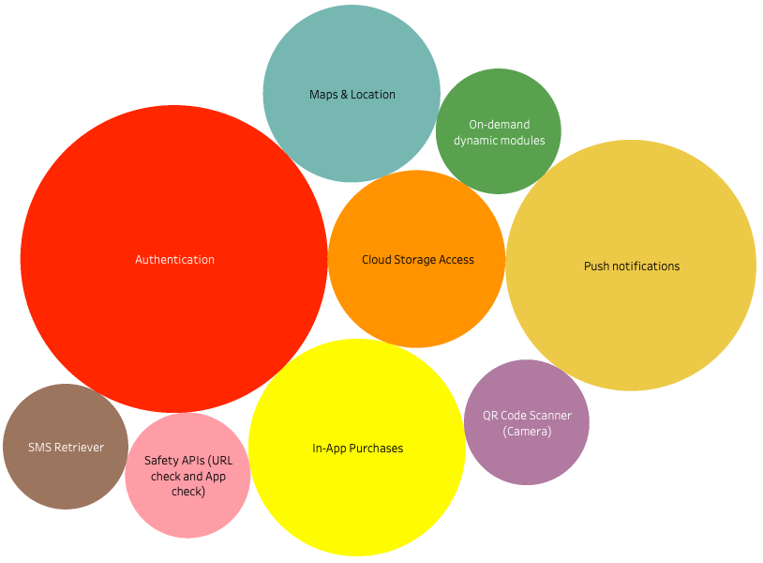
Key Features Impacting Mobile Developers
By understanding which features have the greatest impact, we can prioritize our efforts and focus on addressing the most critical needs of our developer community.
5

Slide 6
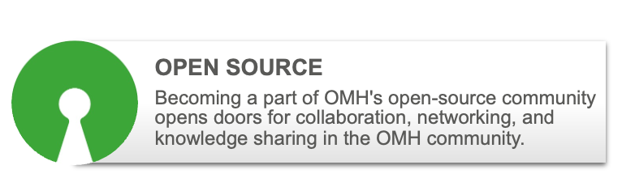
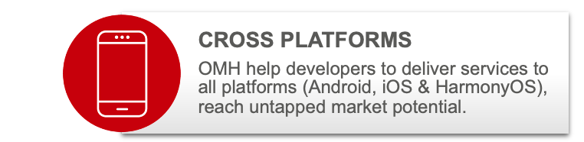

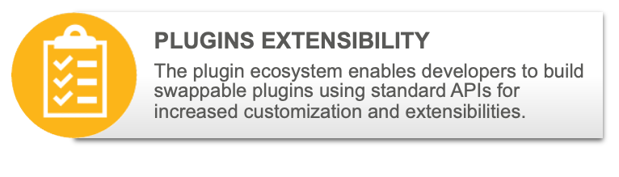















Open Mobile Hub (OMH) Overview
Phase 1.0 (2023)
Phase 2.0 (2024)
Phase 2.5 (2025)
Phase 3.0 (2025)
JavaScript Framework
Login Authentication
Share
Location
Cloud Storage / Backup
Mobile Ads
Monetization
Additional Plug-ins
Cloud Storage Backup
In-App
Payment
Push
Notification
Flutter
Support
ArkUI
Support
Notes:
- Include SOW partner for operationalization, maintenance, support, hosting EU companies
- Mention public cloud from GCP, AWS, or Azure
-

Slide 7
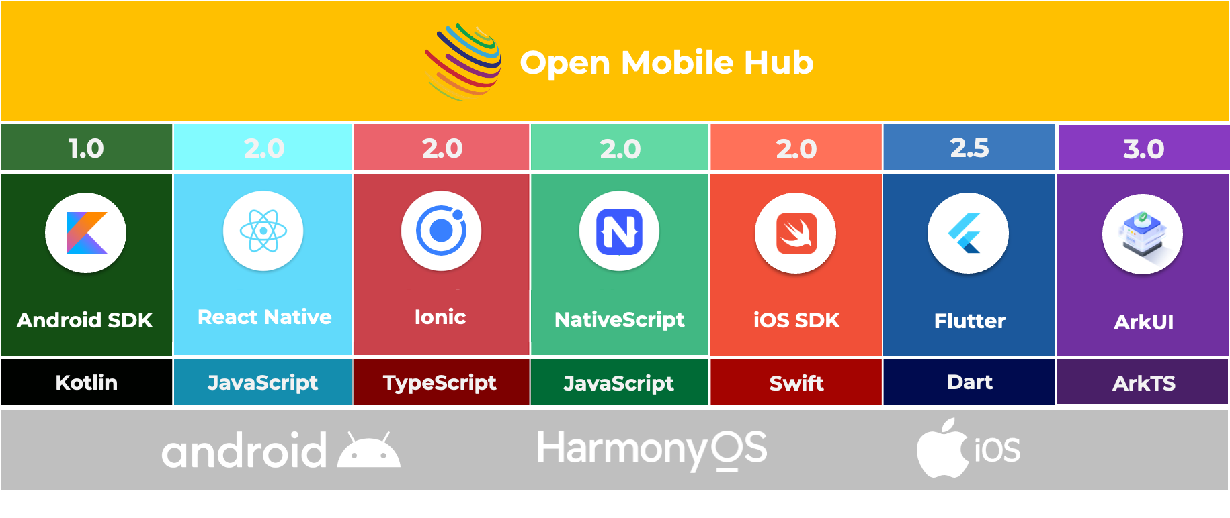
OMH Platform & Framework Agnostic Libraries

Slide 8

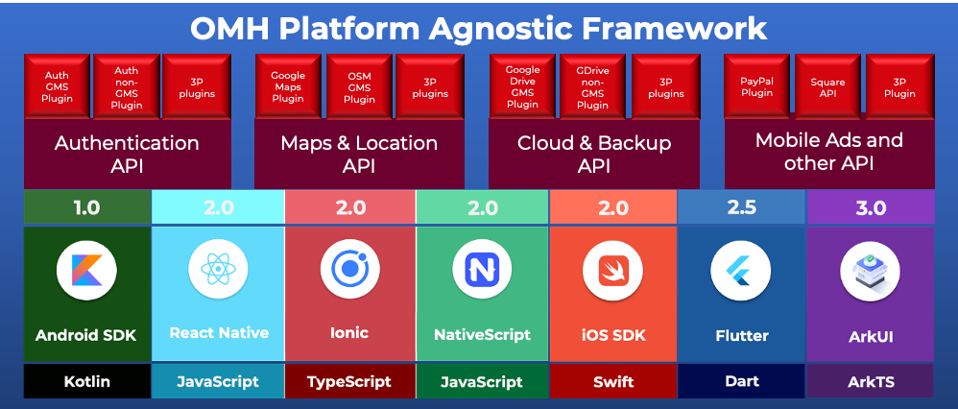
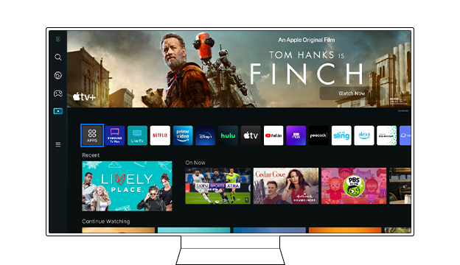

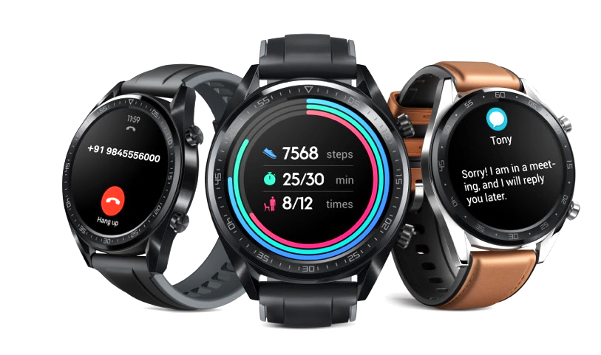
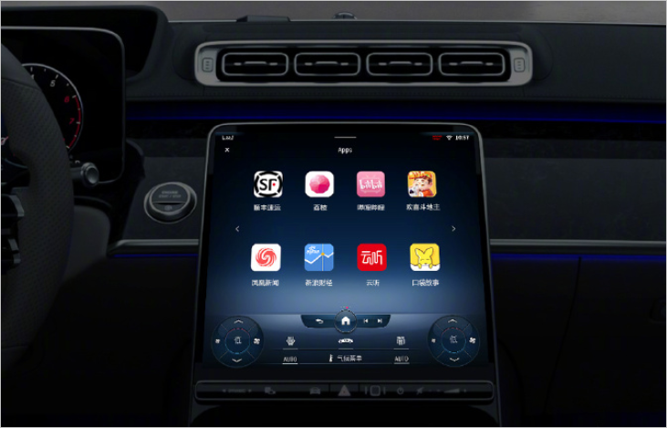
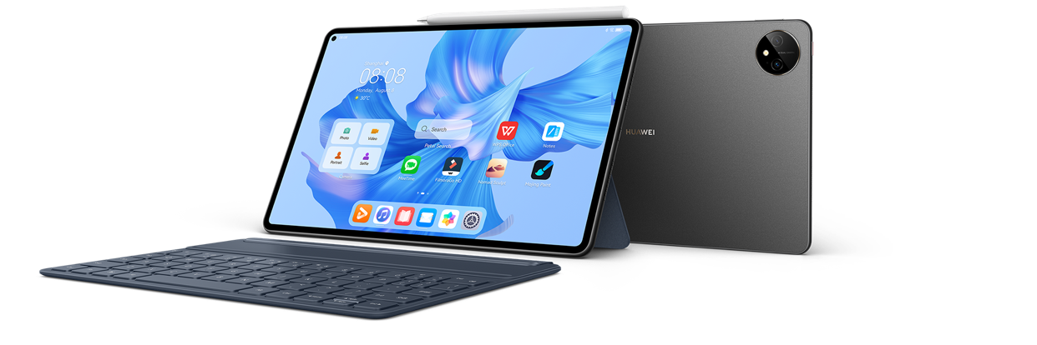
OMH Device-Agnostic Architecture
Device Agnostic
Platform Agnostic
Framework Agnostic
Plugins Architecture
Notes:
- add Appstore, standards, associations

Slide 9
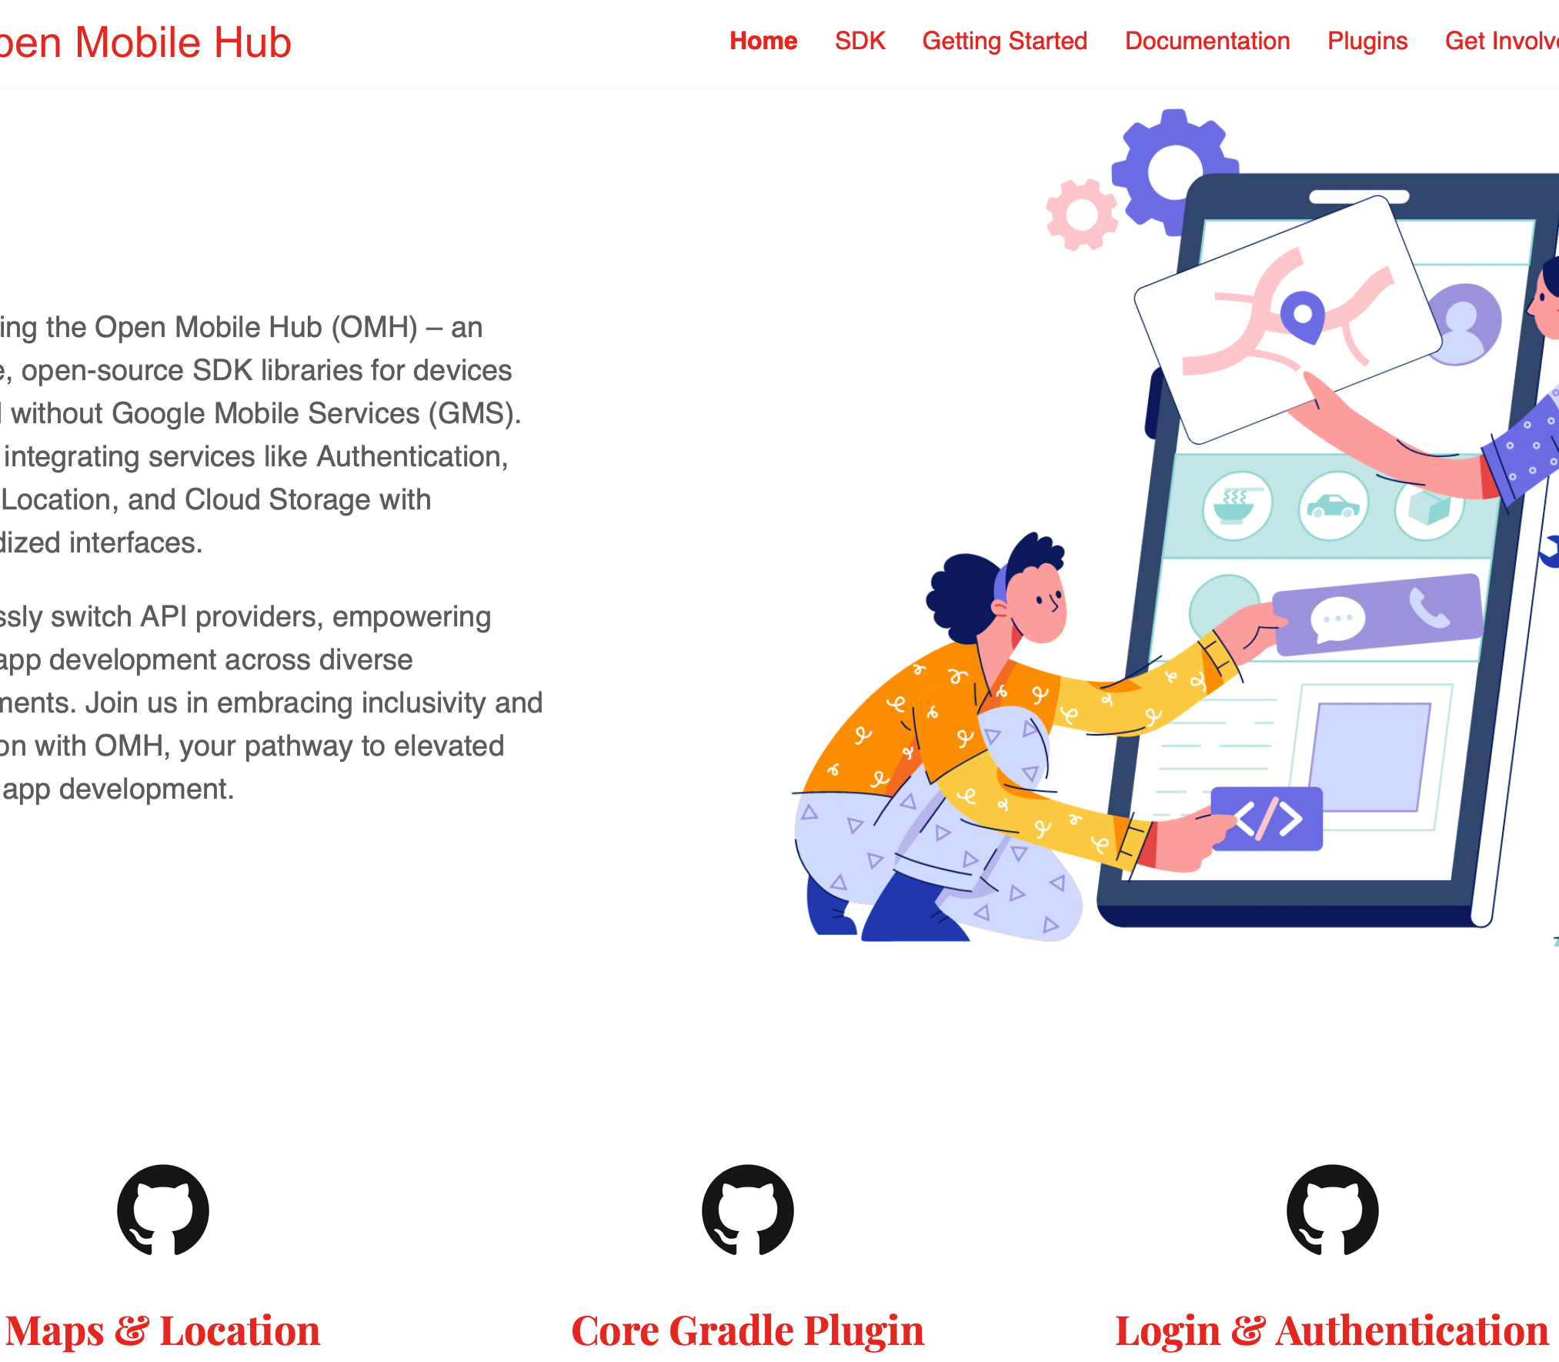
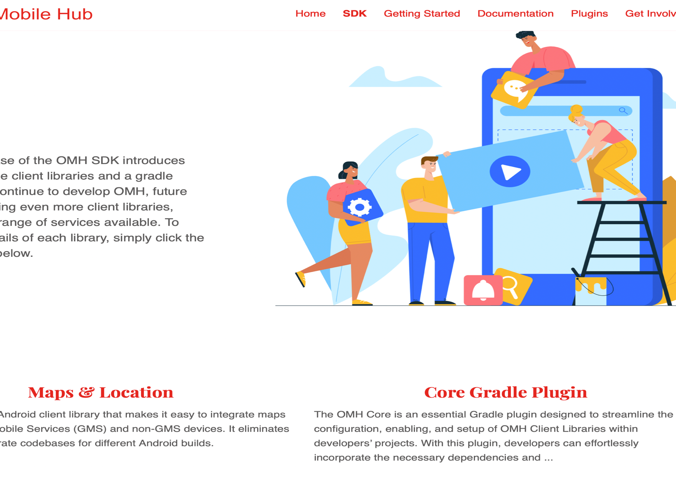
OMH Website
https://www.openmobilehub.com

Slide 10
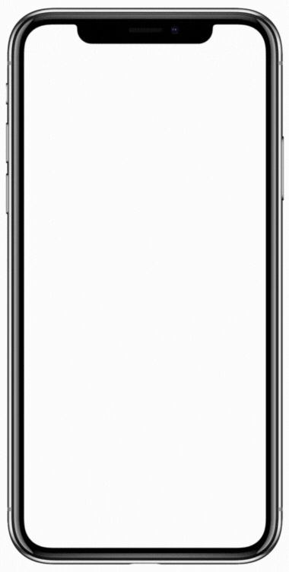
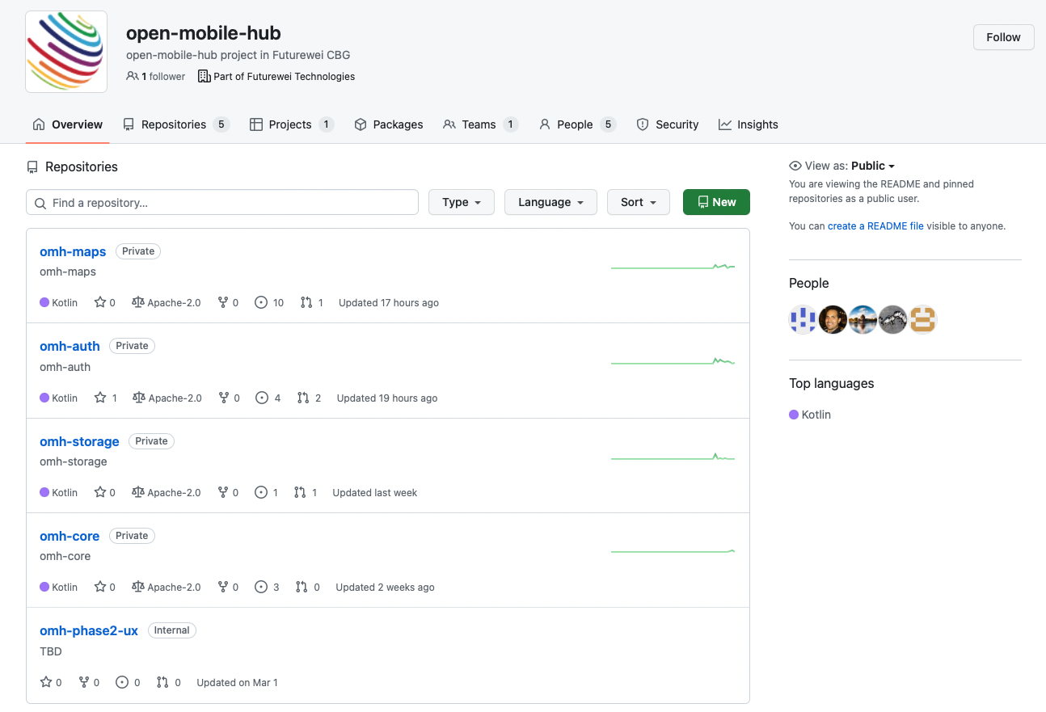
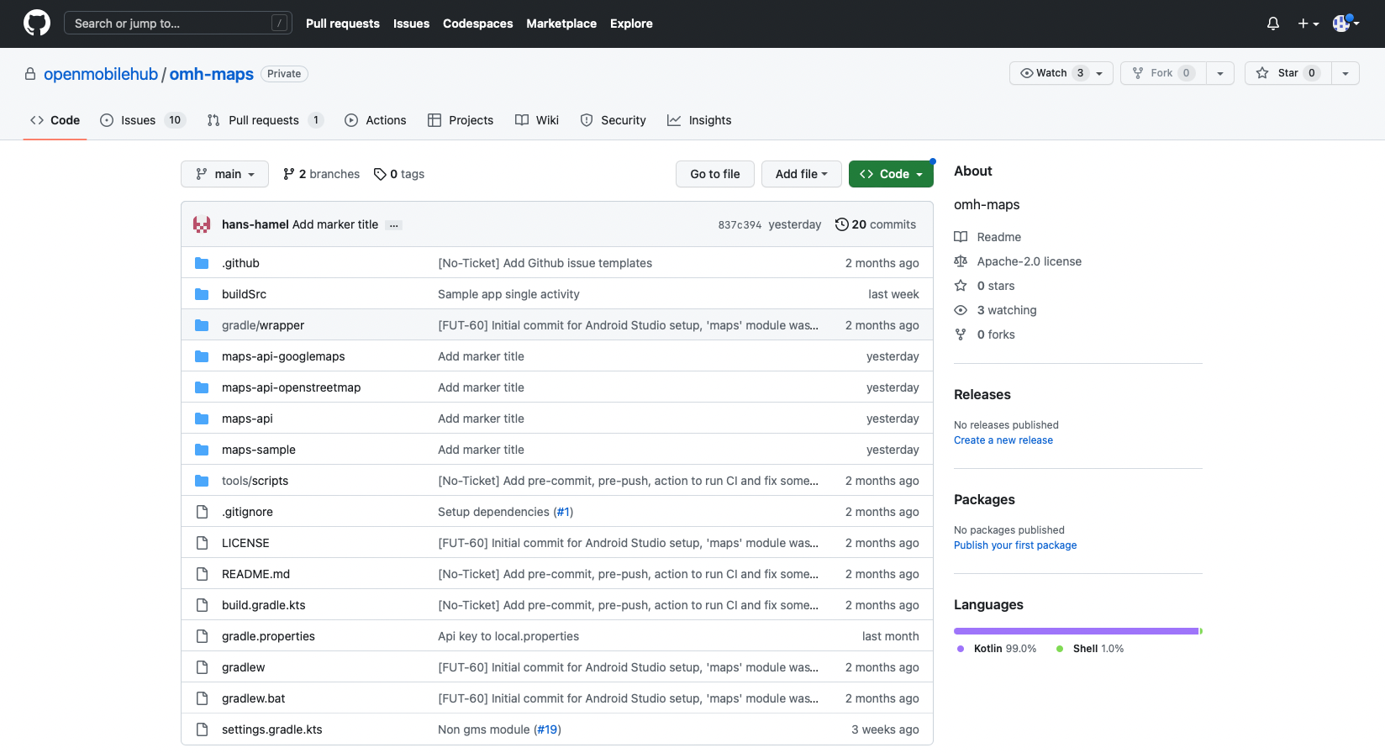
OMH Source Code and Documentation on Github
https://github.com/openmobilehub

Slide 11

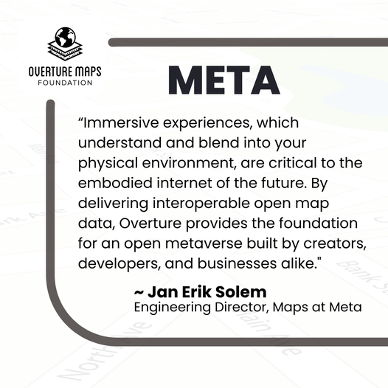


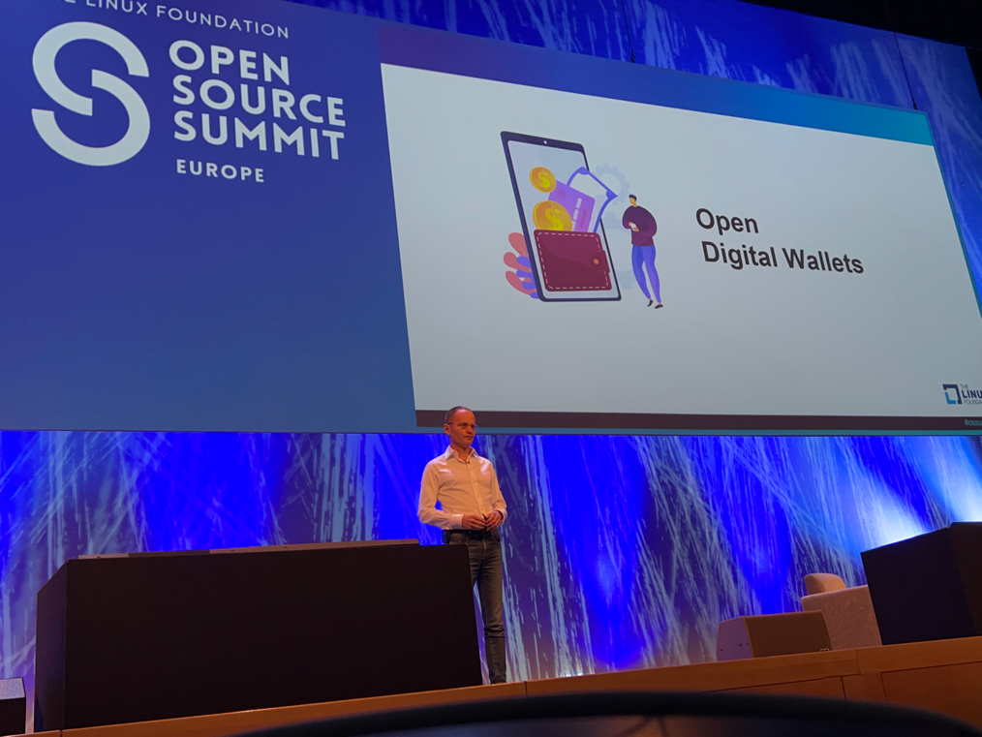




Linux Foundation Research Whitepaper Importance & Benefits of an Open Mobile Ecosystem
30 Pages Research Paper: Focus on understanding the implication of existing laws, regulations, and challenges OEMs, mobile operators, developers and user face; and explore the opportunity to bring an open mobile ecosystem.
Map Building
Global Reference System
Quality Assurance
Structured Data Schema
OpenWallet Foundation: The mission of the OWF is to develop an open-source engine to enable secure and interoperable multi-purpose wallets anyone can use to build solutions.

Slide 12
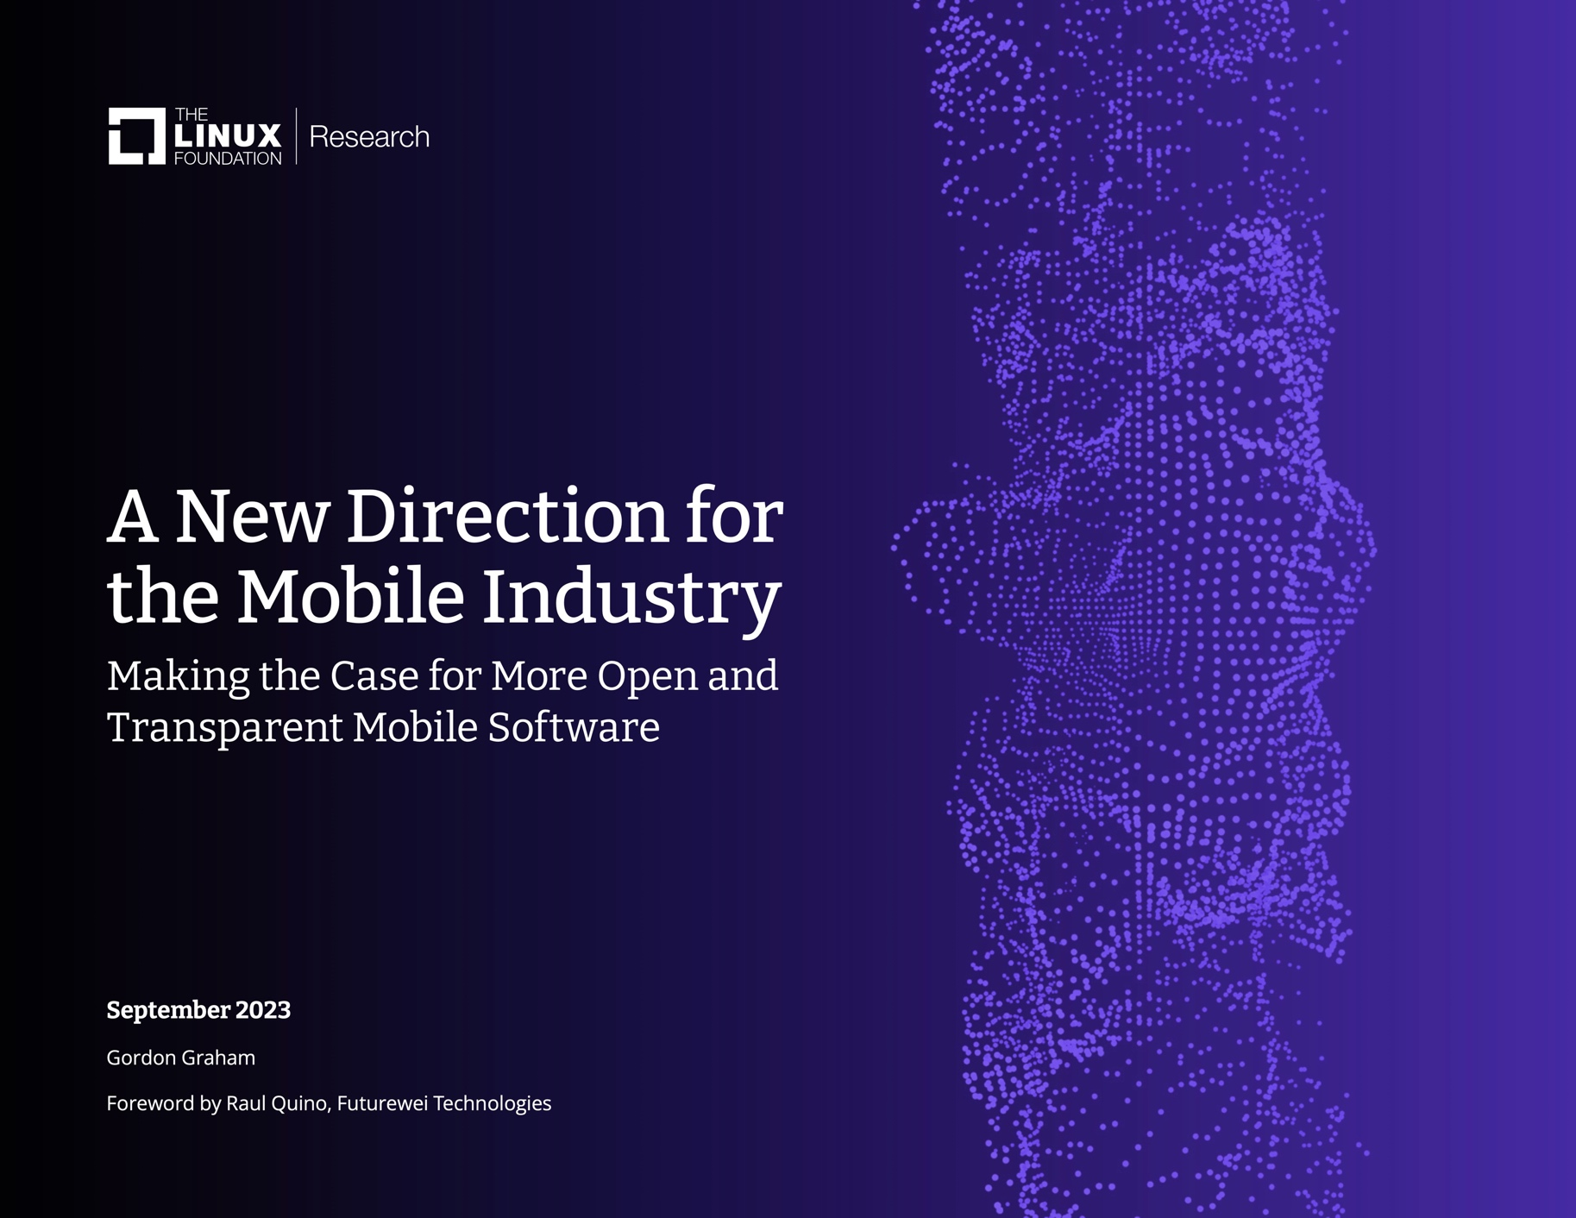
Linux Foundation Research Whitepaper Importance & Benefits of an Open Mobile Ecosystem
The current mobile industry is dominated by Apple and Google, whose platforms account for 99% of all smartphones sold. Global regulators are coming to see this as a market failure with Australia, India, Japan, Mexico, South Korea, the UK, and U.S. are all writing new regulations to foster a more competitive mobile market.
With all the latest development in the mobile industry, we believe there are major advantages to have an open mobile ecosystem. It would increase innovation, make collaboration more efficient, encourage industry standards and interoperability, and help everyone in the ecosystem adapt to evolving markets and changing environments.

Slide 13
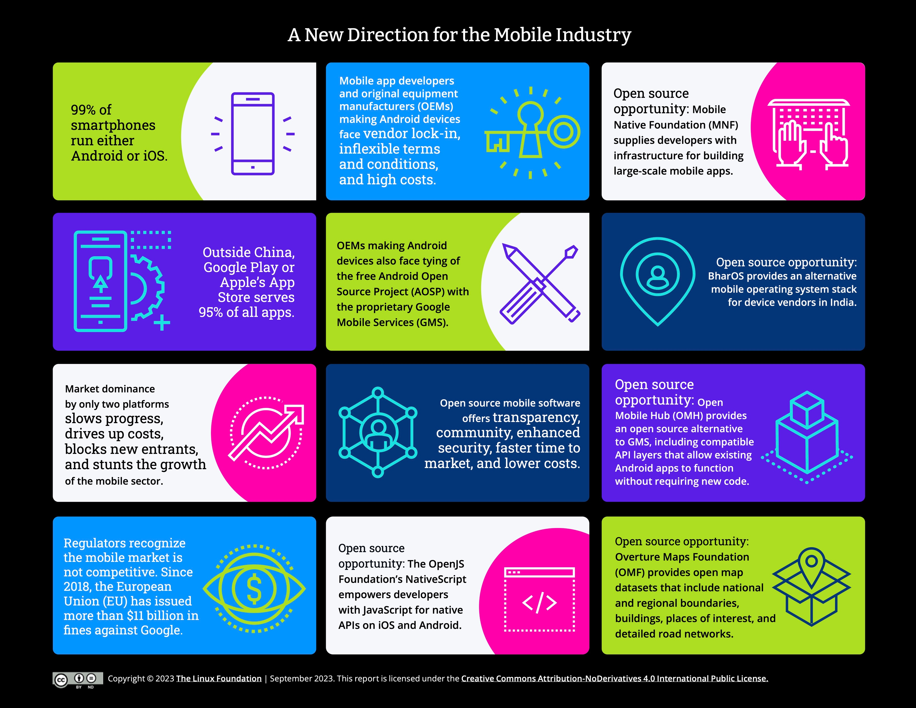

Slide 14
THANK YOU

